Slide 1
Greetings and small talk

Slide 2
Read and translate:
Dobar dan. Ja sam vaša profesorica Jelena.
Dobar dan. Ja sam Dragana.
Dobar dan. Ja se zovem Marko.
Mhm.. Ništa ne razumijem.
Ja sam…
Zovem se…
Moje ime je….

Slide 3
Greetings
When we first meet: Answers:
Zdravo. Ja sam _________. Drago mi je. Ja sam __________.
Ćao. Ja sam____________. Zdravo. Ja sam______________.
When we know each other:
Zdravo. Kako si? Dobro sam. A ti?
Ćao. Kako ide? Dobro sam, hvala. A ti?

Slide 4
Can you think of anymore greetings and answers?
____________________________
____________________________
____________________________
____________________________
____________________________

Slide 5
Translate
What is your name?
I’m _____________.
Where are you from?
I’m from___________.

Slide 6
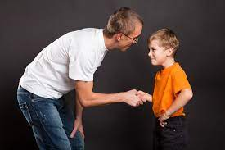
Introduction to children/friends
Hi! I am _________. Zdravo! Ja sam________.
Where are you from? Odakle si?
I am from ________. Ja sam iz ____________.
What is your name? Kako se zoveš?
My name is _______. Zovem se/ ja sam _______.

Slide 7
Introduction to adults
Hello! I am_______. Dobar dan! Ja sam________.
What is your name? Kako se zovete?
My name is _______. Zovem se/ ja sam ______.
Where are you from? Odakle ste?
I am from ________. Ja sam iz ____________.

Slide 8
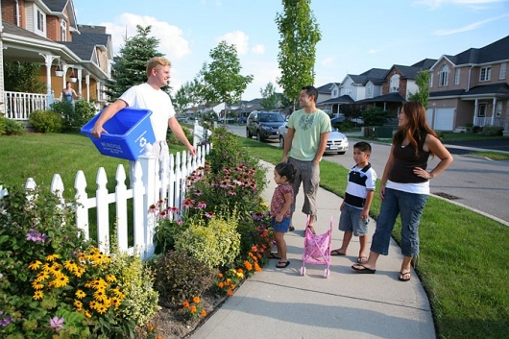
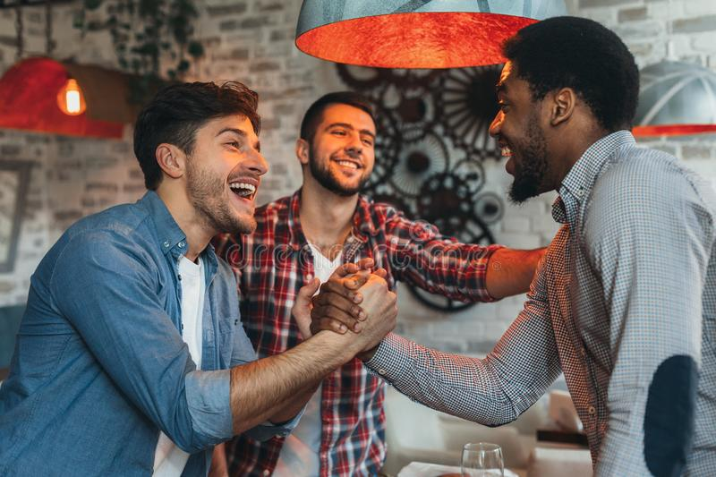
Write dialogues for each picture

Slide 9
Wishes
Welcome! – Dobro došli!
Congratulations! – Čestitam!
Bon appetite! – Prijatno!
Cheers! – Živjeli!
Bless you! – nazdravlje!
Happy birthday! – Srećan rođendan!
Have a nice trip! – Srećan put!

Slide 10
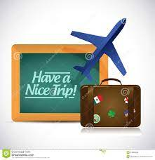
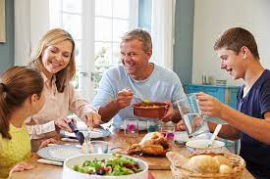
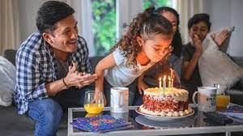
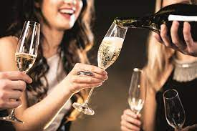
What would say in the following situations?

